Slide 1
Web Systems & Technologies
CS-3548 Prepared By: Junaid Hassan Lecturer at UOS M.B.Din Campus junaidte14@gmail.com

Slide 2
Topic:
Introduction to SQL

Slide 3
SQL Intro:
SQL is a standard language for storing, manipulating and retrieving data in databases.
SQL stands for Structured Query Language
SQL can execute queries against a database
SQL can retrieve data from a database
SQL can insert records in a database
SQL can create, update, delete records in a database
SQL can create new databases
To build a web site that shows data from a database, you will need: an RDBMS database program (i.e. MS Access, SQL Server, MySQL) and a server-side scripting language, like PHP or ASP

Slide 4
SQL Intro:
RDBMS stands for Relational Database Management System. RDBMS is the basis for SQL, and for all modern database systems such as MS SQL Server, IBM DB2, Oracle, MySQL, and Microsoft Access. The data in RDBMS is stored in database objects called tables. A table is a collection of related data entries and it consists of columns and rows.
A field is a column in a table that is designed to maintain specific information about every record in the table.
A record, also called a row, is each individual entry that exists in a table.

Slide 5
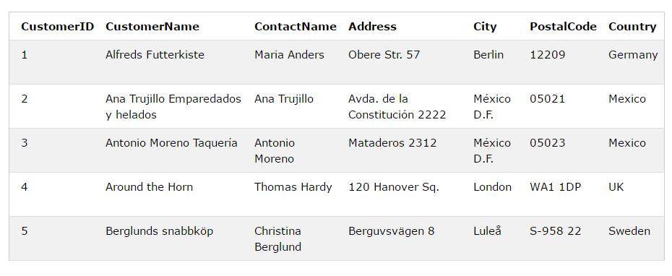
SQL Syntax:
A database most often contains one or more tables. Each table is identified by a name (e.g. "Customers" or "Orders"). Tables contain records (rows) with data.

Slide 6
SQL Syntax:
Most of the actions you need to perform on a database are done with SQL statements. The following SQL statement selects all the records in the "Customers" table:
SELECT * FROM Customers;

Slide 7
SQL Syntax:
Some Important SQL commands:
SELECT - extracts data from a database
UPDATE - updates data in a database
DELETE - deletes data from a database
INSERT INTO - inserts new data into a database
CREATE DATABASE - creates a new database
ALTER DATABASE - modifies a database
CREATE TABLE - creates a new table
ALTER TABLE - modifies a table
DROP TABLE - deletes a table
CREATE INDEX - creates an index (search key)
DROP INDEX - deletes an index

Slide 8
SQL SELECT:
The SELECT statement is used to select data from a database. The data returned is stored in a result table, called the result-set.
SELECT column1, column2, ... FROM table_name;
Here, column1, column2, ... are the field names of the table you want to select data from. If you want to select all the fields available in the table, use the following syntax:
SELECT * FROM table_name;

Slide 9
SQL SELECT DISTINCT:
Inside a table, a column often contains many duplicate values; and sometimes you only want to list the different (distinct) values.
The SELECT DISTINCT statement is used to return only distinct (different) values.
SELECT DISTINCT column1, column2, ... FROM table_name;
SELECT DISTINCT Country FROM Customers;

Slide 10
SQL WHERE:
The WHERE clause is used to filter records. The WHERE clause is used to extract only those records that fulfill a specified condition.
SELECT column1, column2, ... FROM table_name WHERE condition;
SELECT * FROM Customers WHERE Country='Mexico';
SELECT * FROM Customers WHERE CustomerID=1;

Slide 11
SQL AND, OR, NOT:
The WHERE clause can be combined with AND, OR, and NOT operators.
The AND and OR operators are used to filter records based on more than one condition:
The AND operator displays a record if all the conditions separated by AND is TRUE.
The OR operator displays a record if any of the conditions separated by OR is TRUE.
The NOT operator displays a record if the condition(s) is NOT TRUE.

Slide 12
SQL AND, OR, NOT:
SELECT column1, column2, ... FROM table_name WHERE condition1 AND condition2 AND condition3 ...;
SELECT column1, column2, ... FROM table_name WHERE condition1 OR condition2 OR condition3 ...;
SELECT column1, column2, ... FROM table_name WHERE NOT condition;
SELECT * FROM Customers WHERE NOT Country='Germany';
SELECT * FROM Customers WHERE Country='Germany' AND (City='Berlin' OR City='München');

Slide 13
SQL ORDER BY:
The ORDER BY keyword is used to sort the result-set in ascending or descending order. The ORDER BY keyword sorts the records in ascending order by default. To sort the records in descending order, use the DESC keyword.
SELECT column1, column2, ... FROM table_name ORDER BY column1, column2, ... ASC|DESC;
SELECT * FROM Customers ORDER BY Country DESC;
SELECT * FROM Customers ORDER BY Country ASC, CustomerName DESC;

Slide 14
SQL INSERT INTO:
The INSERT INTO statement is used to insert new records in a table.
INSERT INTO table_name (column1, column2, column3, ...) VALUES (value1, value2, value3, ...);
If you are adding values for all the columns of the table, you do not need to specify the column names in the SQL query. However, make sure the order of the values is in the same order as the columns in the table. The INSERT INTO syntax would be as follows:
INSERT INTO table_name VALUES (value1, value2, value3, ...);
INSERT INTO Customers (CustomerName, ContactName, Address, City, PostalCode, Country) VALUES ('Cardinal', 'Tom B. Erichsen', 'Skagen 21', 'Stavanger', '4006', 'Norway');

Slide 15
SQL UPDATE:
The UPDATE statement is used to modify the existing records in a table.
UPDATE table_name SET column1 = value1, column2 = value2, ... WHERE condition;
UPDATE Customers SET ContactName = ‘Junaid', City= ‘M.B.Din' WHERE CustomerID = 1;

Slide 16
SQL DELETE:
The DELETE statement is used to delete existing records in a table.
DELETE FROM table_name WHERE condition;
DELETE FROM Customers WHERE CustomerName=‘junaid';
It is possible to delete all rows in a table without deleting the table. This means that the table structure, attributes, and indexes will be intact:
DELETE * FROM table_name;

Slide 17
SQL CREATE DATABASE:
The CREATE DATABASE statement is used to create a new SQL database.
Syntax:
CREATE DATABASE databasename;
CREATE DATABASE testDB;
We can also create database using PhpMyAdmin / cPanel

Slide 18
SQL DROP DATABASE:
The DROP DATABASE statement is used to drop an existing SQL database.
Syntax:
DROP DATABASE databasename;
Example:
DROP DATABASE testDB;

Slide 19
SQL CREATE TABLE:
The CREATE TABLE statement is used to create a new table in a database.
CREATE TABLE table_name ( column1 datatype, column2 datatype, column3 datatype, .... );
CREATE TABLE Persons ( PersonID int, LastName varchar(255), FirstName varchar(255), Address varchar(255), City varchar(255) );

Slide 20
SQL DROP TABLE:
The DROP TABLE statement is used to drop an existing table in a database.
Syntax:
DROP TABLE table_name;
Example:
DROP TABLE Shippers;
The TRUNCATE TABLE statement is used to delete the data inside a table, but not the table itself:
TRUNCATE TABLE table_name;

Slide 21
SQL ALTER TABLE:
The ALTER TABLE statement is used to add, delete, or modify columns in an existing table.
The ALTER TABLE statement is also used to add and drop various constraints on an existing table.
ALTER TABLE table_name ADD column_name datatype;
ALTER TABLE table_name DROP COLUMN column_name;
ALTER TABLE table_name MODIFY COLUMN column_name datatype;

Slide 22
References:
www.w3schools.com/sql

