Slide 1
Web Engineering
CS-4513 Prepared By: Junaid Hassan Lecturer at UOS M.B.Din Campus junaidte14@gmail.com

Slide 2
Topic:
Web Application Artchitectures (WAA):
Fundamentals of WAA
Specifics of WAA
Components of a generic AA
Layered Architecture
Data-aspect architectures
MVC Architecture

Slide 3
Fundamentals of WAA:
Architecture means how the components are arranged and how these components communicate with each other
Architecure describes the structure
It can be considered a building design and flow chart for a software product
Architecture makes a system understandable
Architecture represents the framework for a flexible system

Slide 4
Fundamentals of WAA:
The quality of an application/software is considerably influenced by its underlying architecture.
Poor performance, insufficient maintainability and expandability, and low availability of a Web application are often caused by an inappropriate architecture
The architecture of an application is influenced by functional requirements, technical constraints, development rules (coding guidelines), distribution aspects (end users) and system integrations.

Slide 5
Fundamentals of WAA:
Frameworks:
A framework is a reusable software system with general functionality already implemented
The framework serves as a blueprint for the basic architecture and basic functionalities for a specific field of application
This means that the architectural knowledge contained in a framework can be fully adopted in the application
High degree of training efforts, lack of standards for integration of different frameworks, dependance on manufacturers

Slide 6
Specifics of WAA:
We can see that Web application requirements are more demanding than requirements for comparable traditional software systems
This development, especially with regard to changeability, performance, security, scalability, and availability, has encouraged the proposal and introduction of specific technical infrastructures both for the development and the operation of Web applications

Slide 7
Specifics of WAA:
Many aspects need to be considered while developing or planning a web application architecture e.g
Internationalization, character sets, representation mechanisms (e.g arabic character from right to left)
Inhomogeneity and immaturity of technical infrastructures
The survey disclosed that newly introduced product versions have been slower than their predecessors, and that new functionalities have caused incompatibilities in the existing application code

Slide 8
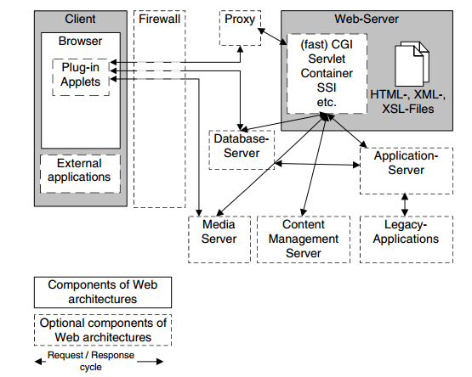
Components of a generic AA:

Slide 9
Components of a generic AA:
Client: Generally a browser (user agent) is controlled by a user to operate the Web application. The client’s functionality can be expanded by installing plug-ins and applets.
Firewall: A piece of software regulating the communication between insecure networks (e.g., the Internet) and secure networks (e.g., corporate LANs). This communication is filtered by access rules.

Slide 10
Components of a generic AA:
Proxy: A proxy is typically used to temporarily store Web pages in a cache. However, proxies can also assume other functionalities, e.g., adapting the contents for users (customization), or user tracking
Web server: A Web server is a piece of software that supports various Web protocols like HTTP, and HTTPS, etc., to process client requests.
Database server: This server normally supplies an organization’s production data in structured form, e.g., in tables.

Slide 11
Components of a generic AA:
Media server: This component is primarily used for content streaming of non-structured bulk data (e.g., audio or video).
Content management server: Similar to a database server, a content management server holds contents to serve an application. These contents are normally available in the form of semi-structured data, e.g., XML documents.

Slide 12
Components of a generic AA:
Application server: An application server holds the functionality required by several applications, e.g., workflow or customization.
Legacy application: A legacy application is an older system that should be integrated as an internal or external component.

Slide 13
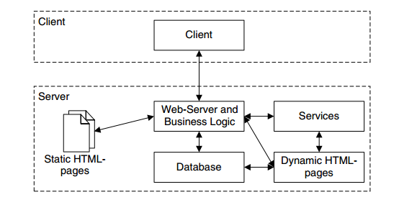
Layered Architectures:
A 2-layer architecture also called client/server architecture, uses a Web server to provide services to a client

Slide 14
Layered Architectures:
2-layer architecture is simplest architecture
A client request can point directly to static HTML pages, without requiring any processing logic on the server layer, or it can access a database via the application logic on the Web server
This architecture is suitable particularly for simple Web applications.

Slide 15
N-Layered Architectures:
N-layer architectures allow us to organize a Web application in an arbitrary number of layers
They typically consist of three layers, the data layer, providing access to the application data, the business layer, hosting the business logic of the application in an application server, and finally the presentation layer, which renders the result of the request in the desired output format

Slide 16
N-Layered Architectures:
Additionally, security mechanisms like firewalls, or caching mechanisms like proxies, can be integrated into the request-response flow upon demand
2-layer and n-layer architectures differ mainly in how they embed services within the application server component
Services like customization or workflow are held in the application server’s context, so that they are available to all Web applications

Slide 17
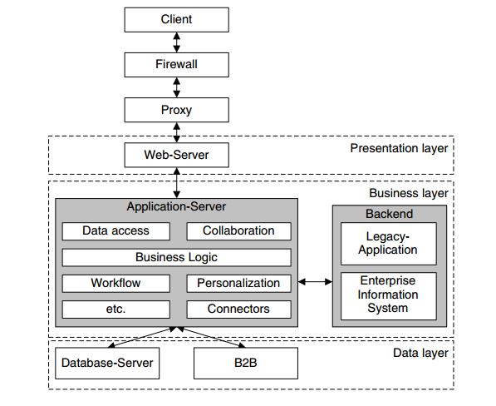
N-Layered Architectures:

Slide 18
Data-Aspect Architectures:
Data can be grouped into either of three architectural categories:
Structured data of the kind held in databases
Documents of the kind used in document management systems
Multimedia data of the kind held in media servers
A number of tools and approaches is available to integrate databases into Web applications

Slide 19
Data-Aspect Architectures:
Since database technologies (and particularly relational databases) are highly mature, they are easy to integrate
Architectures for web document management:
In addition to structured data held in databases and multimedia data held on media servers, contents of Web applications are often processed in the form of documents. Content management architectures support the integration of documents from different sources, representing a mechanism to integrate these contents into Web applications.

Slide 20
Data-Aspect Architectures:
Architectures for multimedia data:
Basically, multimedia data, i.e., audio and video, can be transmitted over standard Internet protocols like HTTP or FTP, just like any other data used in Web applications. This approach is used by a large number of current Web applications , because it has the major benefit that no additional components are needed on the server. Its downside, however, is often felt by users in that the media downloads are very slow

Slide 21
Data-Aspect Architectures:
We can use streaming technologies to minimize these waiting times for multimedia contents to play out.
Streaming in this context means that a client can begin playout of the audio and/or video a few seconds after it begins receiving the file from a server.
This technique avoids having to download the entire file (incurring a potentially long delay) before beginning playout.

Slide 22
MVC Architecture:
Model–view–controller (MVC) is a software architectural pattern. It divides a given application into three interconnected parts in order to separate internal representations of information from the ways that information is presented to and accepted from the user.

Slide 23
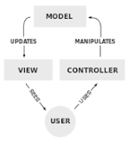
MVC Architecture:

Slide 24
MVC Architecture:
User’s requests are received by controller. Controller communicate with Model according to the request generated by the user.
Model is actually the database layer. It will send/recieve information from database as requested by the user and will send the response to View.
View is the final output/page generated according to the user’s request.

Slide 25
Summary:
Fundamentals of WAA
Specifics of WAA
Components of a generic AA
Layered Architecture
Data-aspect architectures

