Slide 1
Web Engineering
CS-4513 Prepared By: Junaid Hassan Lecturer at UOS M.B.Din Campus junaidte14@gmail.com

Slide 2
Topic:
Technology-Aware Web Application Design
Web design from an evolutionary perspective
Presentation design
Interaction design
Functional design
Outlook

Slide 3
Web Design (Evolution):
Before going into the details of web design (evolution), let’s discuss ‘Technology Aware Web Application Design’:
An application design which is aware of different technologies/platforms
Designed so that it can work/integrate with any technology/platform and its not obsoleet soon.

Slide 4
Web Design (Evolution):
Initially, Tim Berners-Lee wanted to develop the Web to be a simple though worldwide hypertext system via the Internet, and he mainly focused on textual information.
A clash between ‘authors’ and ‘programmers’
Artists vs engineers
Information design (authors) vs software design (programmers)

Slide 5
Web Design (Evolution):
Information Design (Authors):
The beginning of the HTML era was exclusively focused on authoring. Only hypertext documents were supported, as the name of the so-called Web programming language, HTML, suggests: Hypertext Markup Language, a language for instructions – or tags

Slide 6
Web Design (Evolution):
In the course of time, HTML supported other media: images, time-sensitive media, such as video and audio, etc., reflected in the term hypermedia, which is sometimes used to distinguish HTML from hypertext

Slide 7
Web Design (Evolution):
Basically we can divide this evolution perid into 3 parts / eras: SGML era, HTML era, XML era
SGML, a standardized generic markup language for the world of print shops and publishing companies. “Generalized” means that SGML defines valid tags and rules to be used for an entire class of documents (i.e., a specific field of application and the documents it normally uses). The results are document type definitions (DTDs).

Slide 8
Web Design (Evolution):
However, special software has to be written to interpret and execute the instructions specified by tags. Publishing companies use DTDs to distinguish between different book, magazine, and brochure formats, forms, and many other things

Slide 9
Web Design (Evolution):
In the beginning, HTML was nothing but an SGML-DTD for the “screen” format, extended by tags for links and anchors as “grafted on” hypertext functionalities. Later HTML versions corresponded to new DTDs. Browsers of the HTML era are not SGML parsers; instead, they have support for a few DTDs (the supported HTML versions) hardcoded into them, including the way they interpret tags and translate commands. Later on CSS were supported to create any document layout.
Notes:
DTD: Document Type Definition

Slide 10
Web Design (Evolution):
XML is a software- and hardware-independent tool for storing and transporting data
XML stands for eXtensible Markup Language
XML was designed to carry data - with focus on what data is
XML tags are not predefined like HTML tags are
XML stores data in plain text format. This provides a software- and hardware-independent way of storing, transporting, and sharing data.
Notes:
DTD: Document Type Definition

Slide 11
Web Design (Evolution):
Software Design (programmers):
The first steps towards “dynamics” were HTML forms. With their introduction, the significance of script languages increased dramatically, since they could be tailored specifically to the processing needs of browsers or servers and were easy to handle.
Scripts are generally used to create HTML pages on the fly, depending on inputs in an HTML form
Notes:
DTD: Document Type Definition

Slide 12
Web Design (Evolution):
The objective of programmable web was to create / modify the contents of the web page dynamically
This objective was somewhat implemented through Javascript using document object model (DOM)
Where we can access all elements/tags of web document using object model (dot notation) i.e
Document.getElementByTagName(“h1”) etc.
Notes:
DTD: Document Type Definition

Slide 13
Web Design (Evolution):
Presentation design: This design has the output of documents, media, and data (in the sense of an information system, or in the sense of application data of a software component) on its component side
Interaction design: This part is concerned with the control flow of a user’s interaction with a Web application
Functional design: emphasizing the software developer’s perspective i.e the main functionality
Notes:
DTD: Document Type Definition

Slide 14
Presentation Design:
In a presentation design, “media designers” define the look and – to some extent – the structure of how multimedia contents are presented
Modern presentation design follows the conceptual separation of a Web application’s content and its presentation
A good presentation design allows us to flexibly adapt the presentation to various cultural, technological, and contextual requirements

Slide 15
Presentation Design:
In addition, many Web pages, Web applications and entire Web sites are restructured or fitted with a new visual design during their lifecycles
Tools available to create Web applications can be grouped into two categories by how they support the presentation design: conventional page editors and more advanced content management systems

Slide 16
Presentation Design:
Page editors are generally used to create smaller ad-hoc Internet presences. Their major benefits are that they are similar to standard software, which lets users work in a familiar environment, and that they allow to directly format contents.
Their major drawbacks are that HTML knowledge is necessary for non-trivial tasks, and that developers work on page level, which means that they can easily lose the bigger conceptual picture.

Slide 17
Presentation Design:
In contrast to page editors, content management systems allow separating the editorial activities from the layout, facilitating the maintenance of an Internet presence.
This means, however, that the structure of an Internet presentation has to be mapped. The specifics of content management systems are that special tools for various participating roles, e.g., graphic artists or editors, are available, while HTML knowledge is normally not required.
Another benefit is that content, layout, and navigation are separate, the contents of single information units are specified, and workflows can be mapped

Slide 18
Presentation Design:
Device-independent development approaches:
Enhanced requirements on the presentation design result from an increasing demand to consider the trend towards a large number of different Web-enabled devices in the design of Web applications
So in conclusion we have to design the pesentation layer so that it is flexible enough to respond to different devices by dynamically changing the viewport.

Slide 19
Interaction Design:
Interaction design concerns the intersection of the visual, dynamic, functional, and technical elements of Web applications
Its major purpose is to combine these elements and smooth conflicts between them, in order to offer the users an interesting and attractive as well as consistent and easy-to-understand experience
We can divide the interaction of Web applications into four aspects: user interaction, user interface organization, navigation, and user activities.

Slide 20
Interaction Design:
User Interaction:
Interaction design is a process in which designers focus on creating engaging web interfaces with logical and thought out behaviors and actions.
Successful interactive design uses technology and principles of good communication to create desired user experiences.

Slide 21
Interaction Design:
User Interaction:
An interaction designer is the person on the design, development, creative or marketing team that helps form and create a design strategy, identify key interactions of the product, create prototypes to test concepts and stay current on technology and trends that will impact users
To make is it simple: Companies hire an interaction designer to make sure their digital applications work and function in the hands of users.

Slide 22
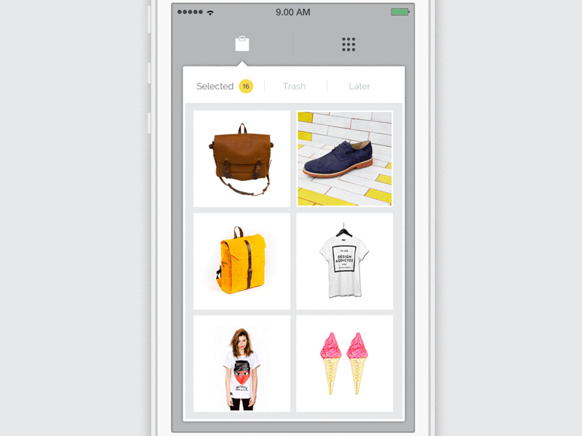
Interaction Design:

Slide 23
Interaction Design :
A fundamental reality of application development is that the user interface is the system to the users. What users want is that the developers should build applications that meet their needs and that are easy to use.
Too many developers think that they are artistic geniuses – they do not bother to follow user interface design standards or invest the effort to make their applications usable, instead they mistakenly believe that the important thing is to make the code clever or to use a really interesting color scheme

Slide 24
Interaction Design :
User interface design important for several reasons:
More intuitive the user interface the easier it is to use.
The better the user interface the easier it is to train people to use it, reducing your training costs.
The better your user interface the less help people will need to use it, reducing your support costs.
The better your user interface the more your users will like to use it, increasing their satisfaction with the work that you have done

Slide 25
Interaction Design :
Tips and Techniques:
Consistency, consistency and consistency: Put your buttons in consistent places on all your windows, use the same wording in labels and messages, and use a consistent color scheme throughout.
If it is difficult to get from one screen to another, then your users will quickly become frustrated and give up.
The text you display on your screens is a primary source of information for your users. If your text is worded poorly, then your interface will be perceived poorly by your users.

Slide 26
Functional Design:
The process of responding to the needs or desires of the people who will use an item in a way that allows their needs or desires to be met
A good functional design means that our applications should be expandable , scalable , and maintainable, among other things. Particular difficulties are seen in the interplay of components

Slide 27
Functional Design:
Integration:
We can integrate systems on three levels, which are to be interpreted as sub-levels of the functional design: the data level, the application level, and the process level
In integration on the data level, we make sure that the data between the representations of different applications are transformed and copied

Slide 28
Functional Design:
Integration:
In integration on the application level (also called object level), the interplay occurs over APIs, which means that time and semantics are closely interleaved
However, many details depend on the middleware used for coupling; this issue will be discussed in the next section

Slide 29
Functional Design:
Integration:
Middleware has been mentioned above as a technology to link applications
For example w3c recommeded XML language can be used a middleware
XML stores data in plain text format. This provides a software- and hardware-independent way of storing, transporting, and sharing data

Slide 30
Outlook:
During the next few years, mobile devices will be of major importance
Therefore, in order to be sustainable, Web applications have to be prepared for this trend today ,namely by considering two important concepts, i.e., context awareness and device independence, which will be discussed

Slide 31
Outlook:
A context-aware application is an application that takes user-specific knowledge – a user’s context – to optimally customize both its interaction and its function
In addition, context awareness leads to new types of applications, e.g., Location-Based Services (LBSs), to mention one example. Depending on the location, we could, for instance, display tailored information about restaurants in a user’s neighborhood

Slide 32
Outlook:
Device-independent applications
The manufacturers of Web Engineering tools have long understood the problem of device independent applications but they have suggested too optimistically that the problem could be solved by transforming a generic (XML-based) presentation to the markup languages used by devices (HTML, WML, etc.)

Slide 33
Outlook:
Device-independent applications
Different implementations of user agents, operating system guidelines, and physical and technical differences of the devices represent major obstacles in practice. To mention a few examples: partly incomplete implementations and different HTML versions, different extent of available user interface elements (e.g., list boxes, radio buttons), screen size and orientation, and limited computing power or network bandwidth.

Slide 34
Outlook:
Device-independent applications
These restrictions have led to several proposals, including WML as a specific markup language for mobile devices

Slide 35
References:
Text book Ch. 5
https://designmodo.com/interaction-design/
http://www.ambysoft.com/essays/userInterfaceDesign.html

